Slide 1
Linux for DevOps Engineer
Pramoth Ravi

Slide 2
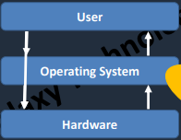
What is Operating System?
OS is an interface between user and the computer hardware

Slide 3
Operating Systems
Windows
OS X (MAC OS)
IBM-AIX
HP-UX •
Solaris
Linux •
RedHat, Ubuntu, fedora, Suse, Debian , cent, amazon linux etc…

Slide 4
Why Linux
Free
Stability
Secure
Community Support

Slide 5
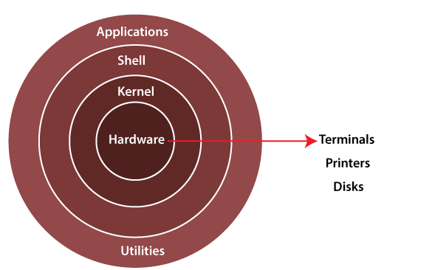
Linux Architecture

Slide 6
Linux Filesystem Hierarchy
Directory | Name Description
/ | This is top level directory It is parent directory for all other directories It is called as ROOT directory It is represented by forward slash (/) C:\ of windows
/root | it is home directory for root user (super user) It provides working environment for root user C:\Documents and Settings\Administrator
/home | it is home directory for other users It provide working environment for other users (other than root) c:\Documents and Settings\username
/usr | by default softwares are installed in /usr directory (UNIX Sharable Resources) c:\program files
/bin | it contains commands used by all users (Binary files)
/sbin | it contains commands used by only Super User (root) (Super user's binary files)
/var | it is containing variable data like mails, log files

Slide 7
Linux Basic commands
date Show the current date and time
cal Show this month's calendar
uptime Show current uptime
whoami who you are logged in as
finger Display information about user
users /id Shows user information
man command Shows manual of command
username Shows your user name
who / w display who is online

Slide 8
View files
ls directory listing
cat filename view file content
less view a file page by page
more output the contents of file
head output the first 10 lines of file
tail output the last 10 lines of file
page display file page by page

Slide 9
Create & Delete file/directory
Touch create a 0 bites file
cat > filename create file and allow to write
nano create a file if filename doesn’t exist
Vi create a file if filename doesn’t exist
rm remove a file
mkdir Create a directory
rmdir Remove a empty directory
rm -rf Remove a directory

Slide 10
Managing files or directories
cp Copy a file
mv Move a file
Find Find a file
grep Search for a pattern in a file
cd Switch between directories
diff Find content difference in 2 files
sed search and replace particular pattern
chmod Change file permissions
chown Change Ownership of a file
file Show what kind of file it is

Slide 11
System Management
history list all commands executed by a user
free Free memory of a server
/proc/meminfo Displays memory information
/proc/cpuinfo Displays CPU information
uname -a show kernel information
du show directory space usage
whereis show possible locations of app
which s how which app will be run by default

Slide 12
Networking
hostname lists host name of the server
ping <ip> availability of destination server over the network
wget download packages/softwars onto Linux system
ifconfig lists IP address(es) of the server
telnet connect to remote host / check port availability status
curl acces the application as from browser

Slide 13
Port Numbers
Port Number Service
21 FTP
22 SSH
23 TELNET
25 SMTP
53 DNS
80 HTTP
443 HTTPS

Slide 14
Software Management
yum is the primary tool for getting, installing, deleting, querying, and managing RedHat Enterprise Linux RPM software packages from official RedHat software repositories, as well as other third-party repositories.
Command:
Yum install <Package Name>
Yum remove <package name >
Yum update <package name>
Yum info <package name>
Yum list available
Yum list installed

Slide 15
Services
service - This controls the starting and stopping of services
chkconfig - This controls which services are set to start on boot
#service <name of the servicey status To check the status of the service
#service <name of the service> start To start the service
#service <name of the service > stop To stop a service
#service <name of the service> reload To reload the service
#service <name of the service> restart restart the service
#chkconfig --1ist To check the availability of service
#chkconfig on To make the service available after restart
#chkconfig <service> off —- To make the service unavailable after restart

Slide 16
Process Management
When you start a program or running an application in Linux, it actually run as a process
A Linux process (a daemon), running in foreground or in the background, uses memory and CPU resources.
ps -ef list the process which are running in the system
kill / kill -9 kill a process or service
fg run the program in the foreground
bg Run the service in the back group
top List top 20 process which are consuming more CPU

Slide 17
Networking
IP Address: An IP address can be thought of as being similar to a phone number. Just as every person who communicates with a telephone is using a phone with a unique phone number, every computer that is on the Internet has a unique IP address. Not only on internet but within an organization every computer is assigned an IP address so that they can communicate with each other.
Command:
ifconfig -a
ip addr

Slide 18
Runlevels
Looks at the /etc/inittab file to decide the Linux run level.
Following are the available run levels
• 0 – halt
• 1 – Single user mode
• 2 – Multiuser, without NFS
• 3 – Full multiuser mode
• 4 – unused
• 5 – X11
• 6 – reboot

Slide 19
Archiving files or directories
gzip Create a compressed file
gunzip Unzip a file
tar extract tar file

Slide 20
Crontab
In any operating system, it is possible to create jobs that you want to reoccur. This process known as job scheduling, is usually done based on user-defined jobs.
For RedHat or any other Linux, this process is handled by the cron service or a daemon called crond, which can be used to schedule tasks
Field | Description | Allowed
MIN | MIN Minute field | 0 to 59
HOUR | Hour field | 0 to 23
DOM | Day of the month | 1-31
MON | Month field | 1-12
DOW | Day of the week | 0-6
CMD |  | any command

Slide 21
Crontab examples
Execute a job at 8:30 on everyday morning
30 8 * * * cmd
Execute a job at 2:00 PM on every Saturday
0 14 * * 16 cmd
Execute a job at 12:00 AM on 1st July
00 00 01 06 * cmd
Execute a job at 3:30 PM on Every month 25th
30 03 25 * * cmd

Slide 22
Copy file between servers
Windows to Linux
Winscp or mobexterm
Linux to Linux
SCP (secure copy) is a command-line utility that allows you to securely copy files and directories between two systems.
scp source file_name username@destination_host destination:destination folder
eg :
scp file1 root@10.0.0.1:/opt

Slide 23
Link Files
There are 2 types of link files. Soft link and Hard link
Soft link | Hard link
SHORTCUT FILE | BACKUP FILE
Size of link file is equal to no. of characters in the name of original file | Size of both file is same
if original file is deleted, link is broken and data is lost | If original file is deleted then also link will contain data
ln –s <src file> <dest file> | ln <src file> <dest file >

Slide 24
I/O Redirection
Redirection is a process where we can copy the output of any command(s), file(s) into a new file. There are two ways of redirecting the output into a file. Using > or >> filename after the command, and
Cat file1 > file 2
cat file1 >> file2
cat file1 file2 > file 3

Slide 25
SSH
The SSH protocol (also referred to as Secure Shell) is a method for secure remote login from one computer to another. It provides several alternative options for strong authentication, and it protects the communications security and integrity with strong encryption.
Port Number : 22
Daemon : sshd
Conf file : /etc/ssh/sshd_config

Slide 26
HTTP
Port Number : 80
Daemon : httpd
Conf file : /etc/httpd/conf/httpd.conf

Slide 27
Grep command
Grep stands for Global Regular Expression Print. It is used to pick out the required expression from the file and print the output.
grep <patron> filename

Slide 28
Sed command
SED command in UNIX stands for stream editor and it can perform lots of functions on file like searching, find and replace, insertion or deletion. Though most common use of SED command in UNIX is for substitution or for find and replace. By using SED you can edit files even without opening them, which is much quicker way to find and replace something in file, than first opening that file in VI Editor and then changing it.
SED is a powerful text stream editor. Can do insertion, deletion, search and replace(substitution).
SED command in unix supports regular expression which allows it perform complex pattern matching.

Slide 29
Learing resource
https://www.geeksforgeeks.org/sed-command-in-linux-unix-with-examples/

Slide 30
find command
find command is used to find the files or directory’s path, it is exactly like the find option in windows where you can search for a file.
Option Usage
-name For searching a file with its name
-user For files whose owner is a particular user
-group For files belonging to particular group

Slide 31
File Permissions
Access modes are different on file and directory
permission Files Directory
r Open the file 'ls' the contents of dir
W Write, edit, append, delete file Add/Del/Rename contents of dir
x T o run a command/shell script To enter into dir using 'cd'

Slide 32
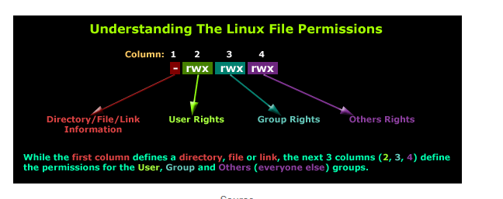
File Permissions

Slide 33
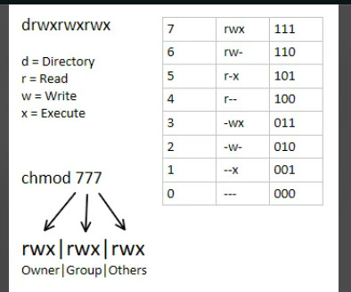
File Permissions Permission can be set on any file/dir by using two methods:-
Symbolic method (ugo)
Chmod u=rwx,g=rw,o=r filename/dir
Chmod ugo=rwx filename/dir
Absolute method (numbers)
Chmod 777 filename
Chmode 460 filename

Slide 34
User Management
In Linux there are three types of users.
1. Super or root user: User is the most powerful user. He is the administrator user.
2. System user: Users created by the softwares or applications.
3. Normal user: Normal users are the users created by root user.

Slide 35
User Creation
Whenever a user is created in Linux, below things happen by default.
A home directory is created(/home/username)
unique UID & GID are given to user
An entry in /etc/passwd
Useradd <optio> <username>
-u user id
-G Secondary group id
-g primary group id
-d home directory
-c comment
-s shell

